Slide 1

TAE-II
Seminar on
“Computer Vandalism and Evidence Correlation” under the course
Cyber Forensics and Investigation(N-PECCM704T)
Under the Guidance
of
Ms. Sweta Bokade
Presented By:
1.Arya Gudgilla (CM23022)
7th Sem, Session:2026-27 (ODD )
Department of Emerging Technologies (AI&ML )

Slide 2
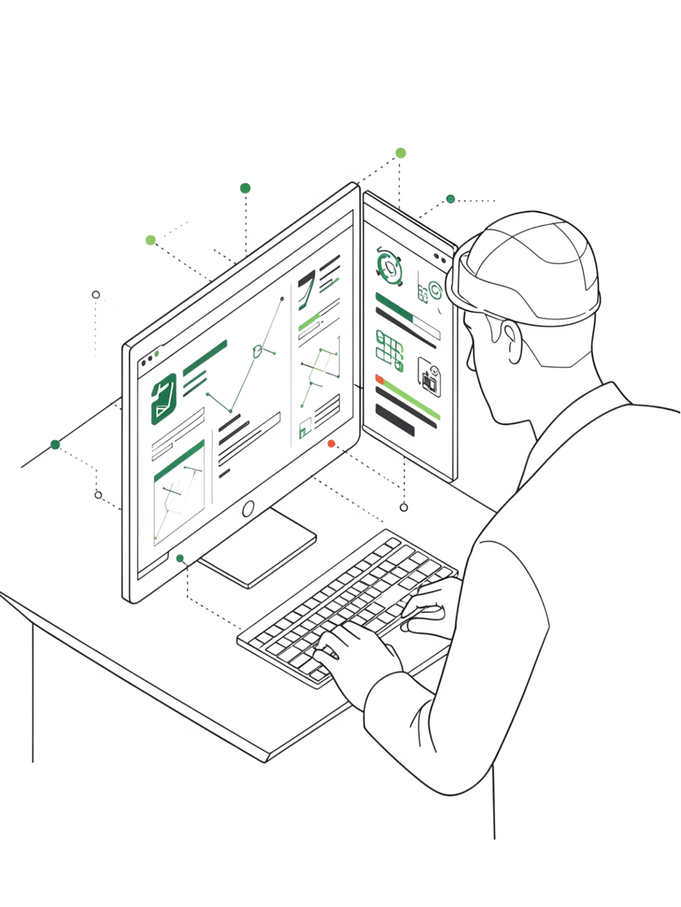
Introduction
Computer Vandalism
Unauthorized modification, deletion, or damage to computer systems, data, or services
Digital Evidence
Information stored or transmitted in digital form that can be used in investigations
Why It Matters
Cyber attacks damage organizations; forensic investigation requires collecting and correlating evidence to identify attackers
Real-World Context
Website defacement, data breaches, and ransomware attacks are growing threats requiring systematic investigation

Slide 3

Computer Vandalism Explained
Access
Control
Threat actor escalates privileges and maintains persistence.
Unauthorized File Modification
Attacker gains unauthorized entry into systems.
Attackers alter or corrupt critical files
Website Defacement
Hackers change website content to display malicious messages
Damage
Impact
Malware Attacks
Systems are altered, corrupted, or sabotaged.
Leads to data loss or service disruption for users.
Deployment of viruses, trojans, or ransomware

Slide 4
Types of Computer Vandalism
Website Defacement
Data Destruction
Unauthorized changes to website appearance or content
Permanent deletion or corruption of critical data
Malware-Based Damage
File Modification
Viruses, trojans, worms causing system harm
Unauthorized changes to system or user files
System Disruption
Hardware Damage
DoS attacks making services unavailable
Physical or logical damage to devices

Slide 5

Digital Evidence
Definition
Any information in digital form that can prove or disprove facts in a cyber investigation.
Digital Device
Sources of Digital Evidence
Data Collection
  Computers and workstations
  Mobile phones and tablets
  Servers and databases
  Network devices (routers, firewalls)
  Cloud storage and services
  System logs and event records
Digital Evidence
Forensic Analysis

Slide 6
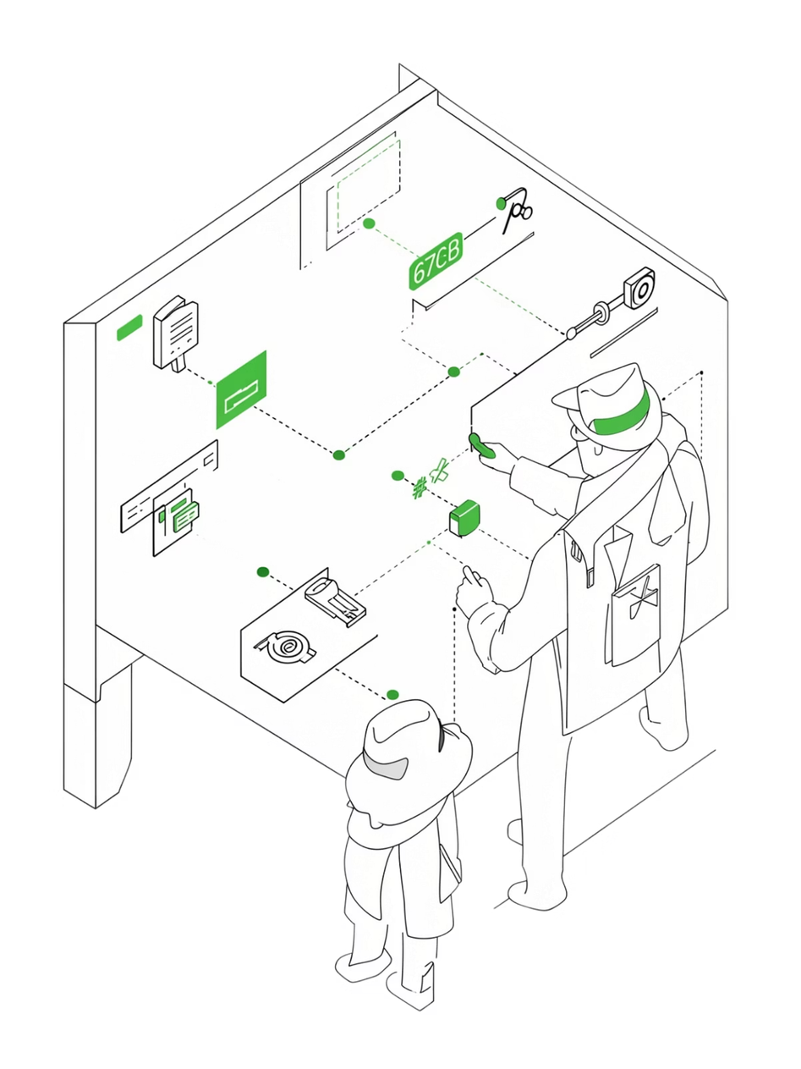
Evidence Correlation
Meaning: Connecting evidence from multiple sources to understand the complete picture of an incident
Key Activities
Goal
  Collect evidence from multiple sources — logs, files, devices
  Compare timestamps and user activities
  Connect users, devices, IP addresses, and files
  Identify relationships between events
  Build a timeline of the incident
Reconstruct exactly what happened and identify the attacker through systematic cross-referencing of all available digital evidence.

Slide 7

Evidence Correlation Process
Forensic Investigation Flowchart
Incident
Preserve
Report
Initial occurrence detected
Maintain chain of custody
Timeline, attribution, and findings
Collect
Analyze
Identify and gather digital evidence
Examine logs, files, correlate data

Slide 8
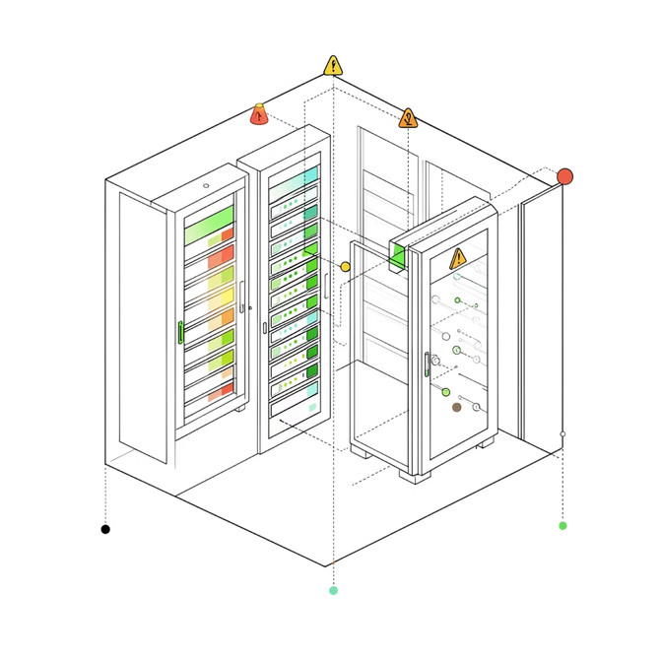
Case Study: Website Defacement
Scenario
An organization's website was defaced with malicious content overnight.
Evidence Correlation Findings
Web Server Logs
File Metadata
Network Logs
Result
Unauthorized login at 2:15 AM from IP 192.168.x.x
Website files modified at 2:17 AM, matching login timestamp
Unusual data transfer detected from that IP address
Correlated evidence identifies attacker's IP, method, and full timeline

Slide 9
Conclusion
Computer Vandalism
Digital Evidence
Evidence Correlation
Causes significant damage to systems and digital information
Crucial for understanding cyber incidents and identifying attackers
Connects information from different sources to reveal the complete attack picture
Proper Preservation
Systematic Investigation
Maintains integrity and admissibility of evidence
Helps reconstruct attacks and support legal proceedings

Slide 10
Thank You
S. B. Jain Institute of Technology Management and research

